Slide 1
Assessment of Electronic Cooling System in a C-shaped Channel Using Temperature Dependant P, PI, PID Controllers
Md Farhan 1710035
Md Tusher Mahmud 1710036
Md Shahed Hossain Sohan 1710043
Mehedi Hasan 1710060
Fayes Us Shoaib 1710070
Ibrahim Hossain 1710077
Department of Mechanical Engineering
Bangladesh University of Engineering and Technology Dhaka-1000, Bangladesh

Slide 2
Overview
Background
Literature Review
Objectives
Physical Model
Mathematical Formulation
Numerical Procedure
Results and Discussion
Conclusion

Slide 3
Background
For a long time, researchers are trying to develop an efficient and effective cooling system for small dimension electronic system.
The complexity of maintaining operating temperature range of the component makes it even harder to fulfill that purpose. Maximizing the heat transfer will not satisfy the need.
Instead a stable and fast control system with most efficient geometric condition is required for achieving the operating temperature range.
Since most modern chips have very small dimensions, it is difficult to implement the cooling system in a compact space.
However, the task can be greatly simplified by the use of P, PI, and PID controllers.

Slide 4
Objectives
To design a cooling system for achieving a cooling effect sufficient enough to maintain operating temperature of an electronic component.
To use P, PI and PID controller for designing the control system.
To incorporate the right controller in the system for controlling the flow based on the temperature sensed by the probe.
To evaluate the optimum value of proportional gain (k_{p}), integral gain (k_{i}), and derivative gain (k_{d}) for the controller.
To get the fastest response time.
To achieve stability of the system.

Slide 5
Literature Review
Author | Shape | Flow condition | Controller
Armaghani et al. [1] | C-shaped | Channel | Absent
Rashad et. al. [2] | U-shaped | Cavity | Absent
Mansour et al. [3] | C-shaped | Cavity | Absent
Yeasmin et al. [4] | L-shaped | Cavity | Absent
Saha et al. [5] | T-shaped | Channel | P, PI, PID
Damasceno and Filho [6] | Shell and Tube | Vented Cavity | PI
Reddy and Balaji [7] | Shell and Tube | Vented Cavity | GA-PID
Prakash et al. [8] | Square | Vented Cavity | P, PI, PID
Shuvo et al. [9] | Square | Vented Cavity | P, PI, PID
Present Study | C-Shaped | Channel | P, PI, PID

Slide 6
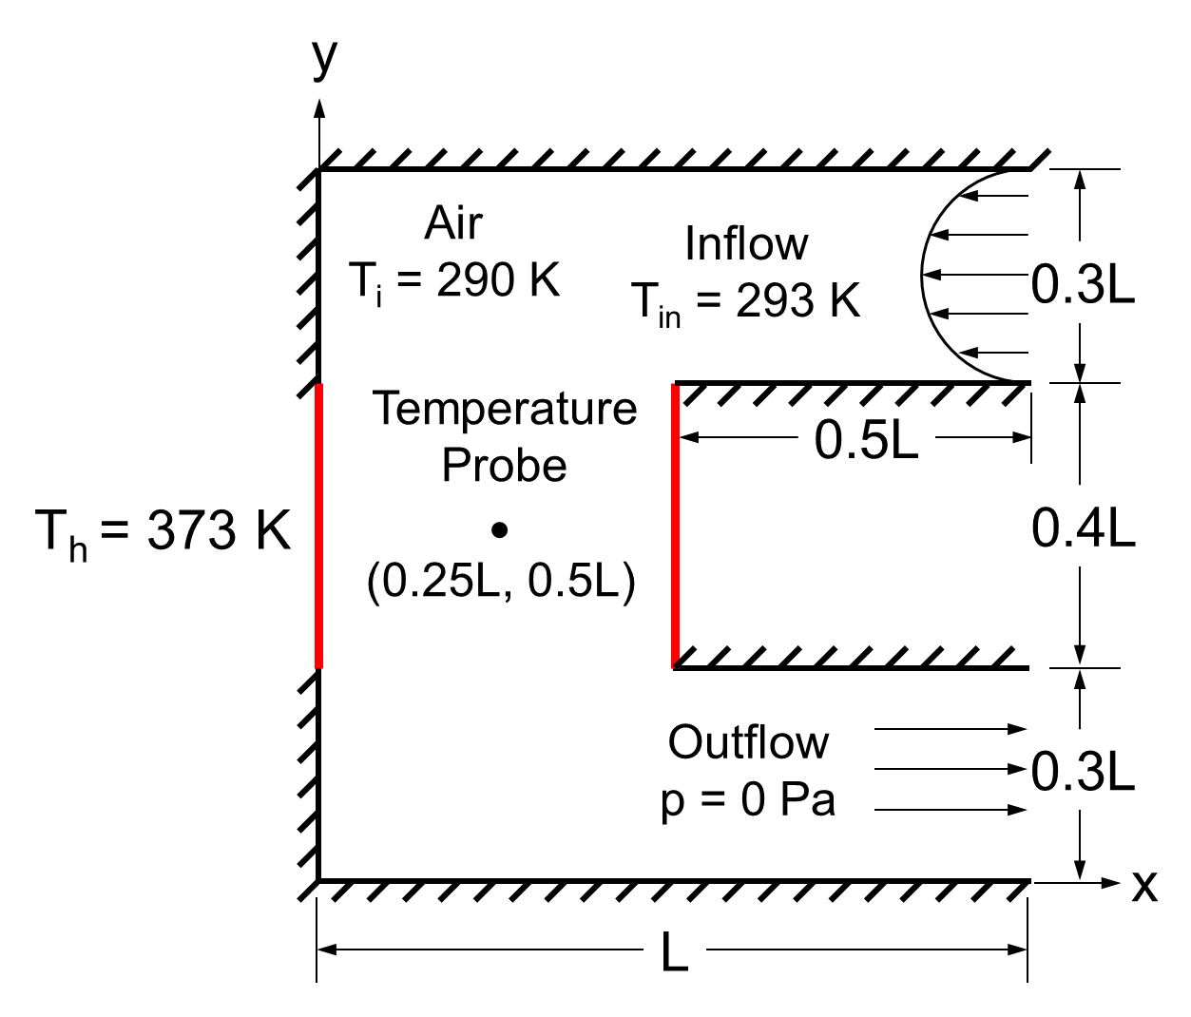
Physical Model
Schematic diagram of the physical model consists of C-shaped enclosure with isothermal heat source (color line)

Slide 7
Boundary Conditions
Boundary | Thermal condition | Velocity Condition
Inlet
Outlet
Heat Source
Cylindrical wall
If T_{p} > T_{set}
If T_{p} ≤ T_{set}

Slide 8
Mathematical Formulation
Continuity equation:
X-Momentum equation:
Y-Momentum equation:
Energy equation for flow domain:

Slide 9
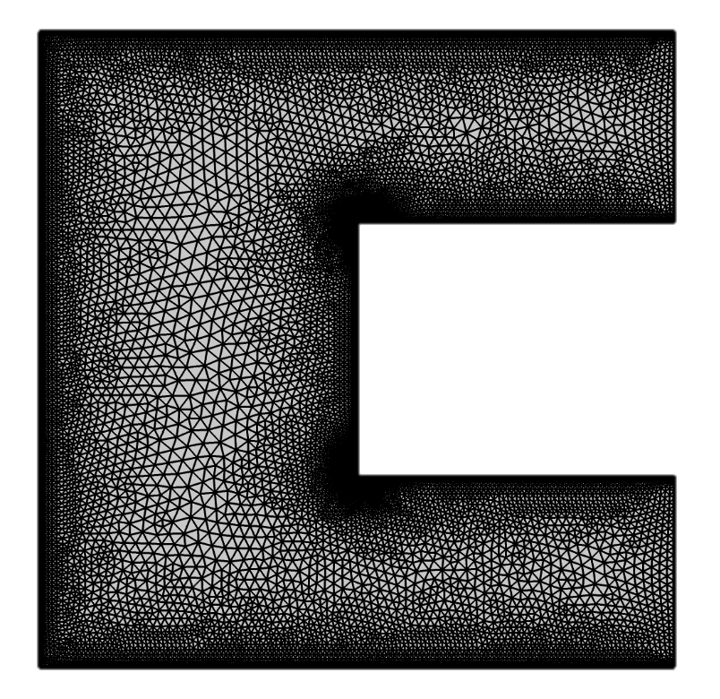
Numerical Procedure
Galerkin Finite Element Method based on Weighted Residual Method has been deployed to conduct the numerical simulation by the commercial software COMSOL Multiphysics 6.0
Optimum mesh information:
Mesh Property | Statistics
Number of Nodes | 11784
Number of Elements | 21370
Triangles | 19954
Quads | 1416
Edge elements | 780
Vertex elements | 10
Average element quality | 0.8051
Element area ratio | 0.001005
Meshed geometry of the C-shaped channel

Slide 10
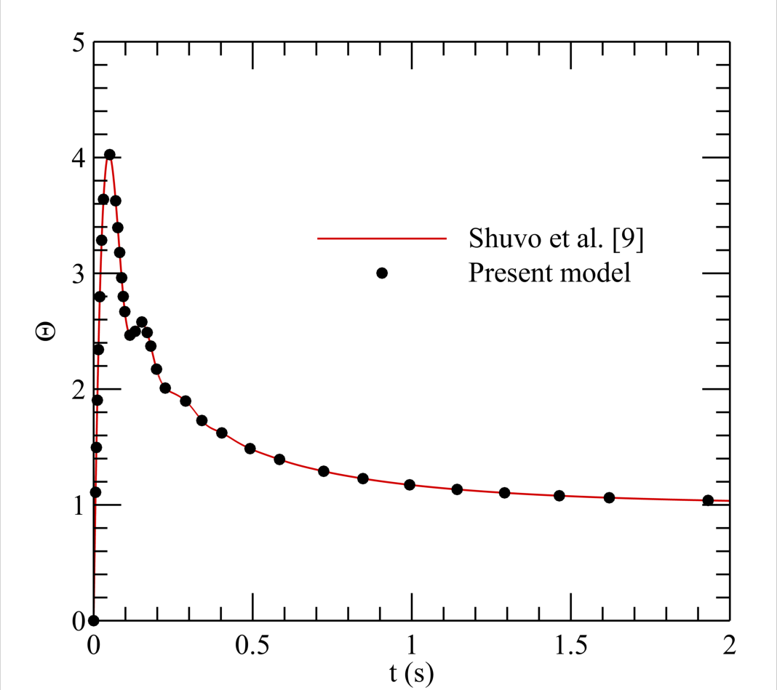
Validation
Validation of the present model in terms of Θ at Kp = 0.01 ms⁻¹K⁻¹, Ki = 0.1 ms⁻²K⁻¹ and Kd = 0.00001 mK⁻¹ with the results of Shuvo et al. [9]

Slide 11
Results and Discussion
P Controller
Advantages
Easy to implement
Decreases rise time and sensitivity
Gain increase reduces steady state error
Transfer function
Disadvantages
Overshoot increases
Cannot eliminate steady state error

Slide 12
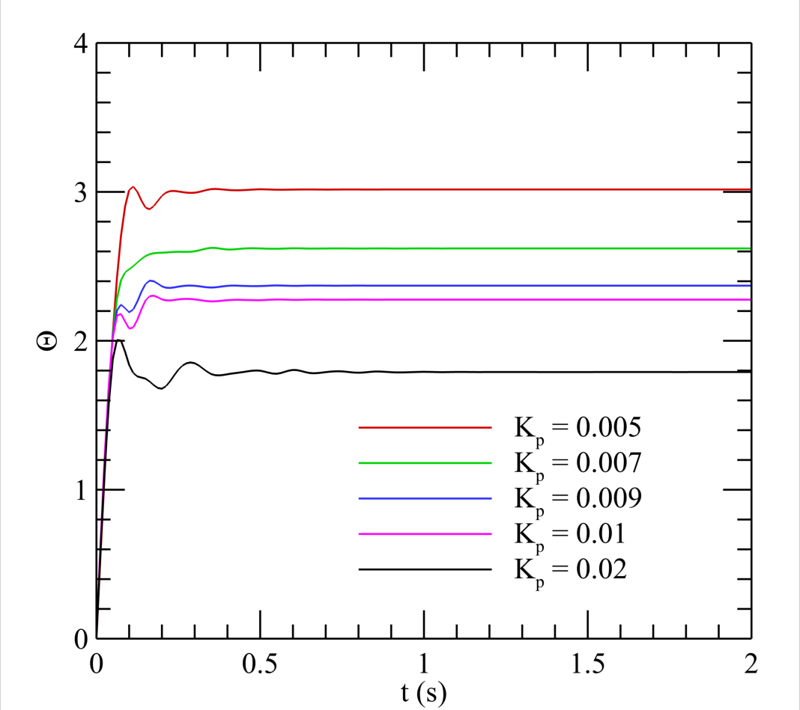
Results and Discussion
P Controller
At higher gain, Kp
Overshoot
Steady state error
Stability
Rise time
Settling time:
0.8s for K_{p}= 0.02
0.4s for K_{p} = 0.005, 0.007, 0.009, 0.01 ms⁻¹ K⁻¹
Figure: Variation of response for P controller in terms of Θ at different level of gain.

Slide 13
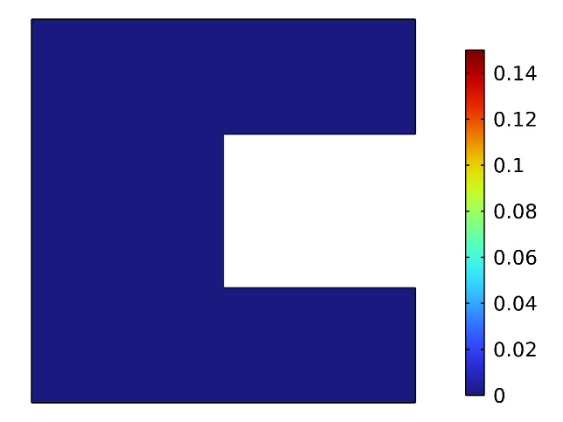
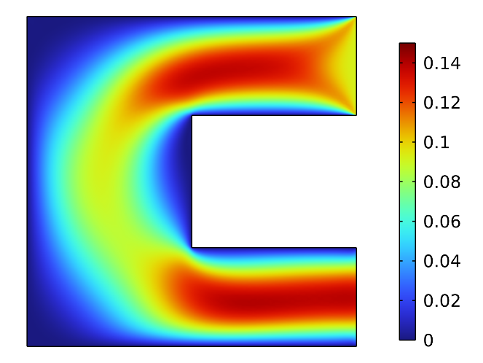
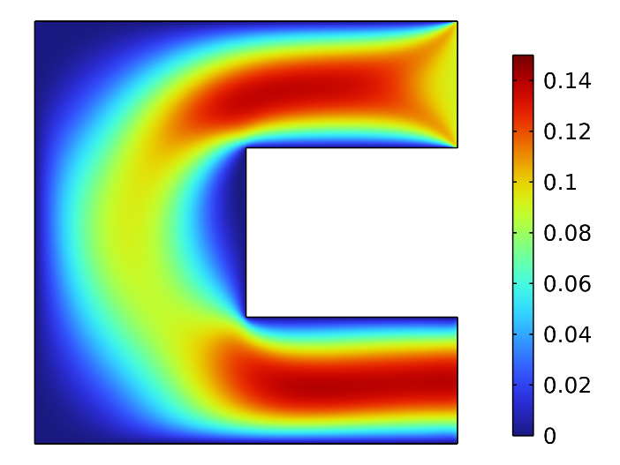
Results and Discussion
P Controller
Velocity Distribution
(a) t = 0 s
(b) t = 0.2 s
(c) t = 2 s
Figure: Variation in flow velocity through the channel in terms of surface plot for K_{p} = 0.007 ms⁻¹ K⁻¹, at (a) t = 0 s, (b) t = 0.02 s, and (c) t = 2 s.
Initially No flow(t =0 s)
Outlet velocity is higher in magnitude

Slide 14
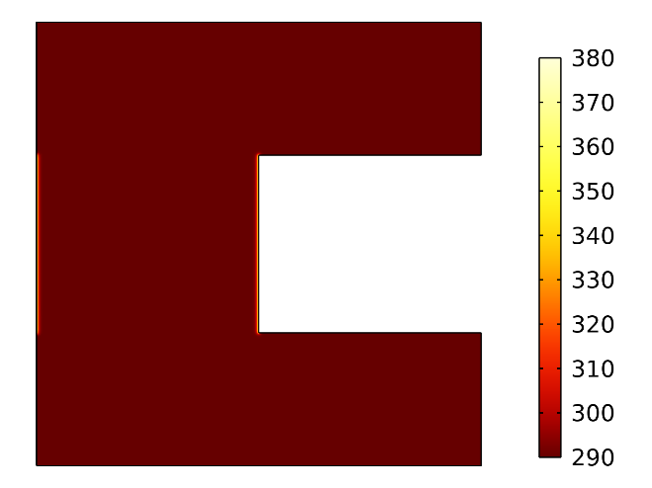
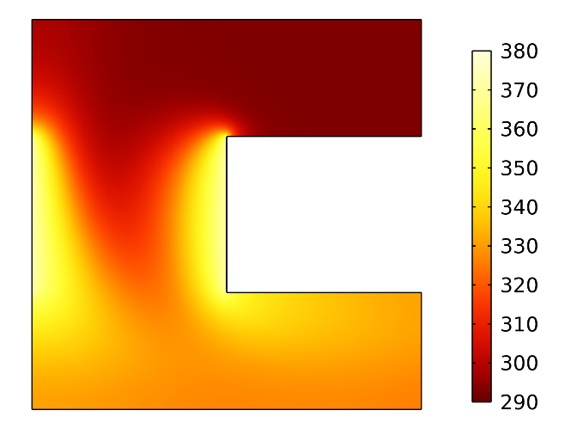
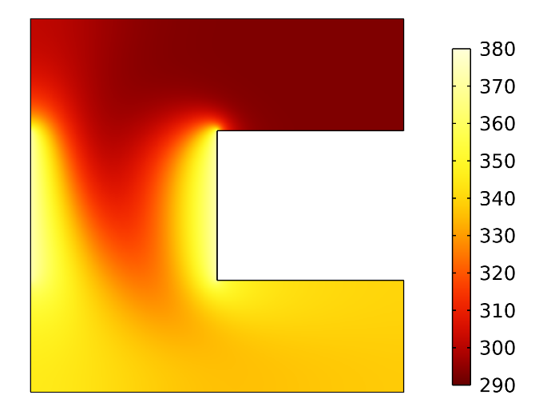
Results and Discussion
P Controller
Thermal field:
(a) t = 0 s
(b) t = 0.2 s
(c) t = 2 s
Figure: Variation of thermal flow field in terms of surface plot inside the cavity at (a) t = 0 s (b) t = 0.2 s (c) t =2 s using P controller at Kp = 0.007 ms⁻¹K⁻¹
The forced flow continues until the temperature at the desired point reaches the desired setpoint temperature.

Slide 15
Results and Discussion
PI Controller
Advantages
Eliminate steady-state error
Decreases rise time and sensitivity
Offset both P and I controller problems
Transfer function
Disadvantages
Overshoot increases
Oscillating behavior is present
Sluggish response compared to P controller

Slide 16
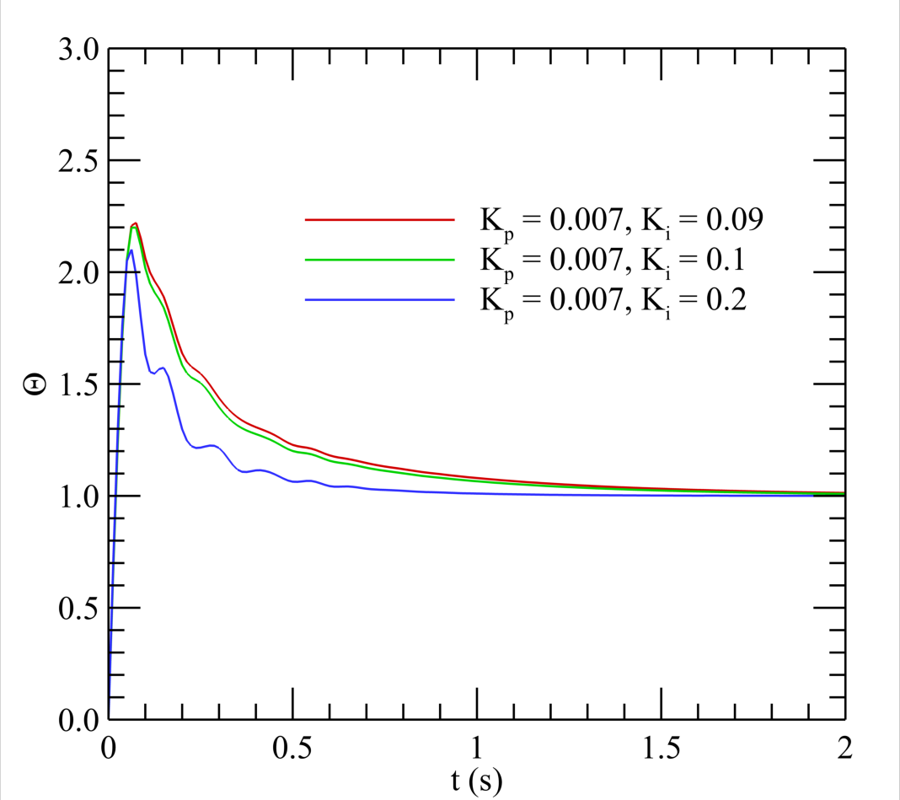
Results and Discussion
PI Controller
At a higher gain, Ki
Overshoot
Stability
Settling time
Settling time:
0.7s for K_{i} = 0.2
1.7s for K_{i} = 0.09, 0.1
Overshoot:
110% for K_{i} = 0.2
120% for K_{i} = 0.1
125% for K_{i} = 0.0.09
Figure: Variation of response for PI controller in terms of Θ at different level of gains.

Slide 17

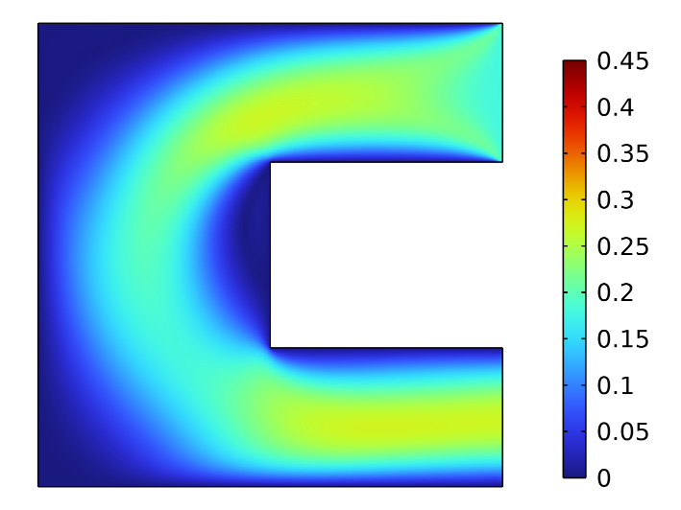
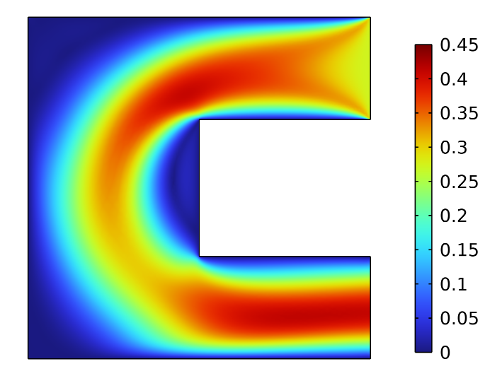
Results and Discussion
PI Controller
Flow field:
(a) t = 0 s
(b) t = 0.2 s
(c) t = 2 s
Figure: Variation in flow velocity through the channel in terms of surface plot for K_{p} = 0.007 ms⁻¹ K⁻¹, K_{i} = 0.2 ms⁻²K⁻¹ at (a) t = 0 s, (b) t = 0.02 s, and (c) t = 2 s.

Slide 18
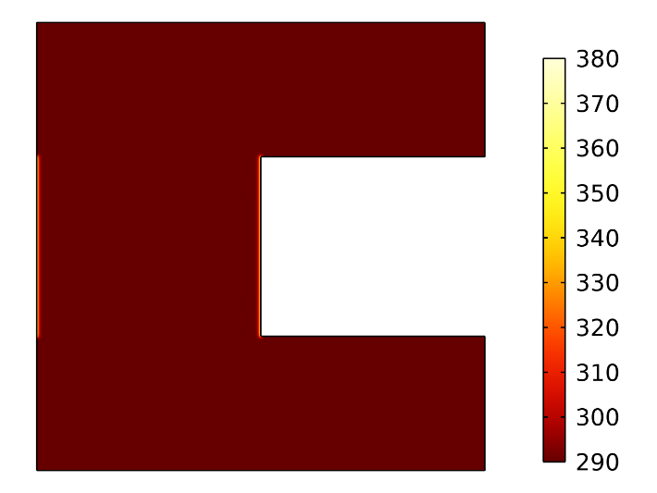
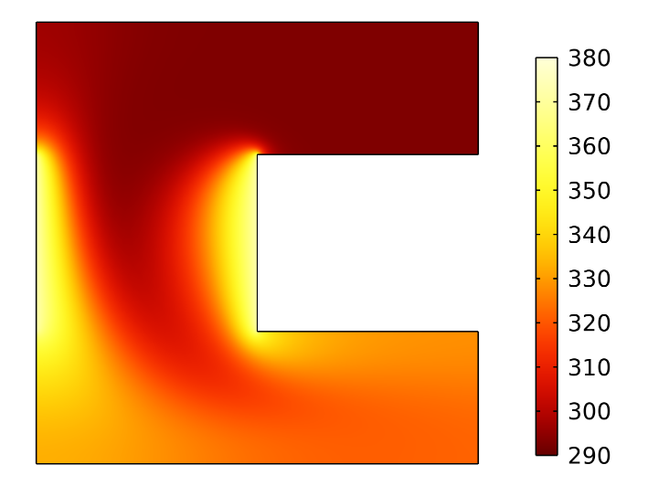
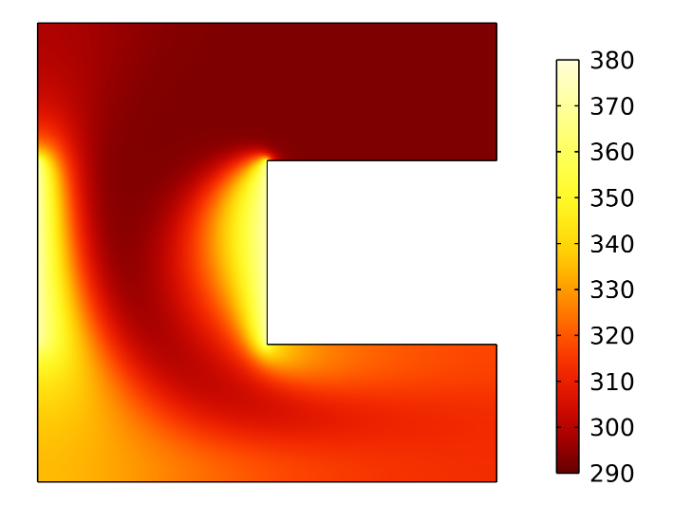
Results and Discussion
PI Controller
Thermal field:
(a) t = 0 s
(b) t = 0.2 s
(c) t = 2 s
Figure: Variation in fluid temperature through the channel in terms of surface plot for K_{p} = 0.007 ms⁻¹ K⁻¹, K_{i} = 0.2 ms⁻²K⁻¹ , at (a) t = 0 s, (b) t = 0.02 s, and (c) t = 2 s.

Slide 19
Results and Discussion
PID Controller
Proportional feedback gain reduces the steady state error.
The integral portion makes it zero but system becomes less stable.
Derivative controller improves the stability of the system without affecting the steady state error.
Transfer Function:
The PID controller takes the advantage of all 3 controllers analyzed here.

Slide 20
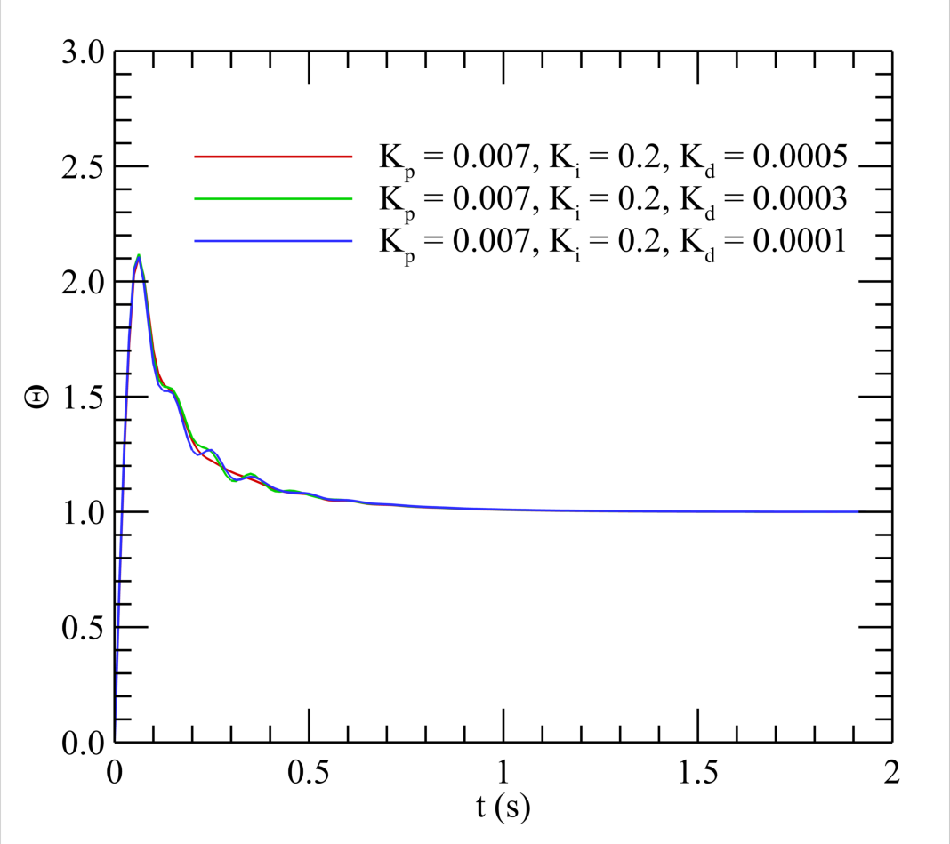
Results and Discussion
PID Controller
%Overshoot = 110%
Settling time, T_{s} = 0.96s
Figure: System Response of PID controller with Θ for K_{d} = 0.0001, 0.0003, 0.0005 mK⁻¹ at K_{p} = 0. 007 ms⁻¹ K⁻¹, K_{i} = 0.2 ms⁻²K⁻¹.

Slide 21
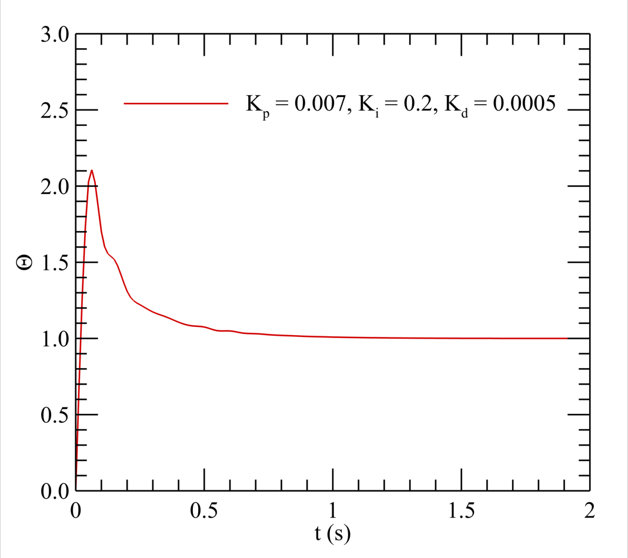
Results and Discussion
PID Controller
At K_{d} = 0.0005 mK⁻¹
Less jerking
Smoother response
Lower settling time (0.85s)
Figure: System Response of the PID controller with Θ for K_{d} = 0.0005 mK⁻¹ at K_{p} = 0. 007 ms⁻¹ K⁻¹, K_{i} = 0.2 ms⁻²K⁻¹.

Slide 22
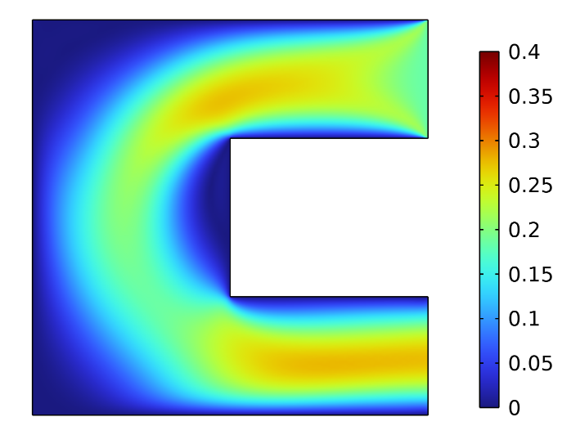
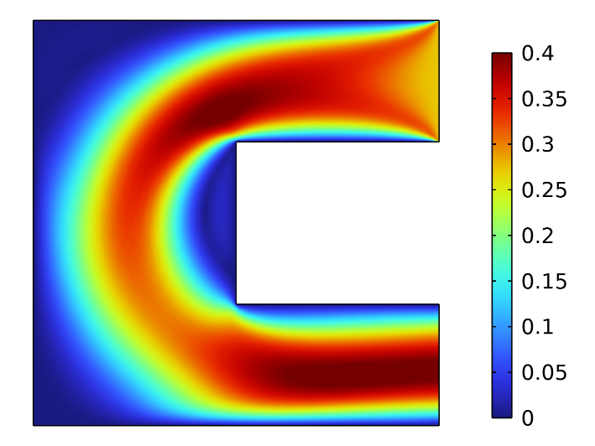
Results and Discussion
PID Controller
Flow field:
(a) t = 0 s
(b) t = 0.2 s
(c) t = 2 s
Figure: Variation in flow velocity through the channel in terms of surface plot for K_{p} = 0.007 ms⁻¹ K⁻¹, K_{i} = 0.2 ms⁻²K⁻¹, and K_{d} = 0.0005 mK⁻¹ at (a) t = 0 s, (b) t = 0.02 s, and (c) t = 2 s.

Slide 23
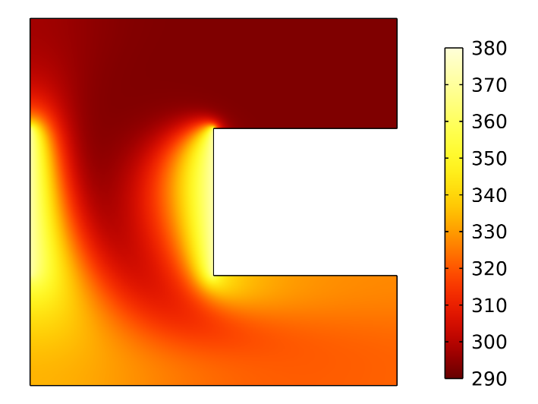

Results and Discussion
PID Controller
Thermal field:
(a) t = 0 s
(b) t = 0.2 s
(c) t = 2 s
Figure: Variation in fluid temperature through the channel in terms of surface plot for K_{p} = 0.007 ms⁻¹ K⁻¹, K_{i} = 0.2 ms⁻²K⁻¹, and K_{d} = 0.0005 mK⁻¹ at (a) t = 0 s, (b) t = 0.02 s, and (c) t = 2 s.

Slide 24
Conclusion
P controller’s steady state performance is worse at lower gain.
At higher value of gain system becomes more unstable and show oscillations.
Maximum overshoot increases at higher value of gain
PI controllers are slower than P controllers and do eliminate steady-state error, although they are faster with higher Ki values. Regardless of Ki values, the steady state is always errorless. And, as a result of the combination, performance may vary depending on the value.
PID controller stabilize the system, make it smoother and reduces the steady state error to zero.

Slide 25
Acknowledgement
We would express our profound gratitude to the Dr. Sumon Saha, Professor, Department of Mechanical Engineering, Bangladesh University of Engineering and Technology (BUET) for providing continuous support throughout our research works.​​

Slide 26
References
[1] T. Armaghani, H. Esmaeili, Y.A. Mohammadpoor, I. Pop, "MHD mixed convection flow and heat transfer in an open C-shaped enclosure using water-copper oxide nanofluid," Heat Mass Transf. Und Stoffuebertragung. 54 (2018) 1791–1801.
[2] A.M. Rashad, M.A. Mansour, T. Armaghani, A.J. Chamkha, "MHD mixed convection and entropy generation of nanofluid in a lid-driven U-shaped cavity with internal heat and partial slip," Phys. Fluids. 31 (2019).
[3] M.A. Mansour, T. Armaghani, A.J. Chamkha, A.M. Rashad, "Entropy generation and nanofluid mixed convection in a C-shaped cavity with heat corner and inclined magnetic field," Eur. Phys. J. Spec. Top. 228 (2019) 2619–2645.
[4] S. Yeasmin, M.M. Billah, M.Z. Molla, K.E. Hoque, "Numerical analysis of unsteady mixed convection heat transfer characteristics of nanofluids confined within a porous lid-driven L-shaped cavity," Int. J. Thermofluids. 16 (2022) 100218.
[5] S. Saha, S. Mojumder, S. Saha, "Regulation of flow through a T-Shaped open cavity by temperature dependent P, PI, and PID controllers," AIP Conf. Proc. 1754 (2016).

Slide 27
References
[6] N. Castelo Damasceno, O. Gabriel Filho, "PI controller optimization for a heat exchanger through metaheuristic Bat Algorithm, Particle Swarm Optimization, Flower Pollination Algorithm and Cuckoo Search Algorithm," IEEE Lat. Am. Trans. 15 (2017) 1801–1807.
[7] C. Somasundar Reddy, K. Balaji, "A Genetic Algorithm (GA)-PID Controller for Temperature Control in Shell and Tube Heat Exchanger," IOP Conf. Ser. Mater. Sci. Eng. 925 (2020).
[8] K. c. Prakash, E. Ahmed, M.M. Hossain, S. Saha, "Regulation of flow using P, PI and PID controllers inside a temperature controlled cold room," AIP Conf. Proc. 2324 (2021).
[9] M.S. Shuvo, F. Ishtiaq, T. Jamee, J. Das, S. Saha, "Analysis of internal cooling system in a vented cavity using P, PI, PID controllers," Results Eng. 15 (2022) 100579.

Slide 28
THANK YOU

